Slide 1
SuperUsers HR System
Ortagus Winfrey
Mechal Terfie
Shenila Daredia
Dalya Khatun
Ryan Ocampo

Slide 2
Problem Statement
We aim to develop a flexible Human Resource Management System specifically for medium-sized Grocery store corporations. This system will utilize SQL for database inquiries. From this a company would be able to create departments as tables, and would allow employees to be placed into departments. A considerable business restraint would be that the system will have to be accessed via a web browser interface.
Notes:
Business constraint- physical and software requirements for application to work

Slide 3
Roles
Ortagus Winfrey- Analyst
Ryan Ocampo- Architecture/back-end
Mechal Terfie- Backend/testing
Shenila Daredia- Frontend/back-end
Dalya Khatun- Frontend/back-end/testing
Notes:
Ortagus Winfrey-Analyst
Ryan OCampo-Architecture/backend
Mychal Terfie-Backend/testing
Shenila Daredia-Frontend/mysql development
Dalya Khatun-Frontend/backend; testing

Slide 4
Entities

Slide 5
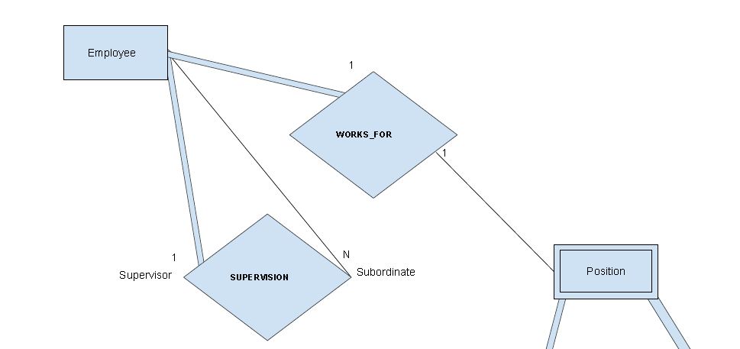
<Employee>
Workers that make up the company
Has a 1:1 relation with our <Position> entity
“Every employee works one position, but every position may not be filled by an employee.”
Partial Participation
Notes:
Ortagus

Slide 6
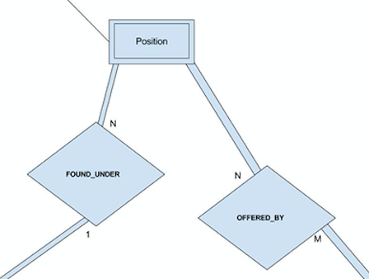
<Position>
Identifying role within the company
Has an N:1 relation with our <Department> entity
“Individual departments can have many positions”
Full Participation
Notes:
Shenila

Slide 7
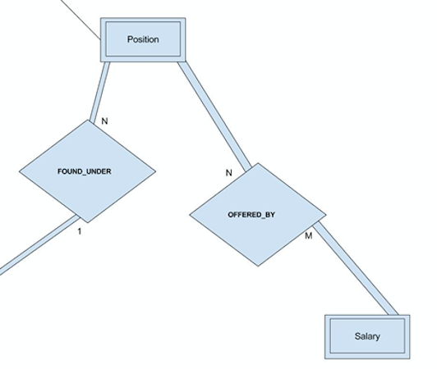
<Salary>
Initial income provided by work position
Has an M:N relation with our <Position> entity
“There can be one, or numerous positions that have the same, or different, salaries.”
Full Participation
Notes:
Ryan

Slide 8
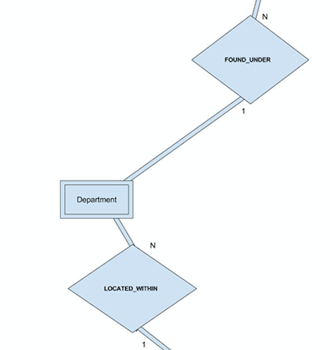
<Departments>
Specified divisions that focus on different production aspects of a company
Has an N:1 relation with our <Store> entity
“Various amounts of departments can be considered for each store.”
Full Participation
Notes:
Mechal

Slide 9
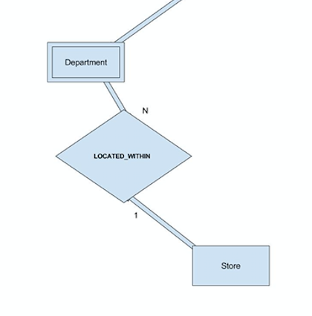
<Store>
The location where each employee,position, and department are located.
Has an 1:N relation with our <Department> entity
“Individual stores can have many departments.”
Partial Participation
Notes:
Dalya

Slide 10
ER Diagram

Slide 11
